Slide 1
Palo Alto configuration, policy deployment using ansible
Used two ways:
-Virtual environment -WSL
#Can use aws services

Slide 2
Use Cases 1:
Firewall Migration & Policy Migration
While migrating firewalls, Ansible can automate the migration of existing policies, reducing manual errors and ensuring consistency.
Working:
Source Firewall (Old Firewall) → Ansible Playbook (Transform & Modify Policies if needed) → Destination Firewall (New Firewall)
Policies and configurations are migrated using Ansible automation.

Slide 3
Use Case 2:
Automated Security Policy Enforcement
Ansible Playbook → Multiple Firewalls
Security policies get deployed consistently across all firewalls.
A centralized Ansible control node pushing security rules to multiple Palo Alto firewalls

Slide 4
User Case 3:
Bulk User & Role Management
Ansible Playbook → Multiple Palo Alto Firewalls
Users (Admin, Read-Only, Custom Roles) are created and assigned automatically.
A structured user role table with different access levels being pushed to multiple firewalls.

Slide 5
Windows with Vscode -Venv
Add virtual env using command: python –m venv venv
Activate the venv using .\venv\Scripts\Activate
Install ansible(pip install ansible)
Add a configuration file for ansible using the command: notepad ansible.cfg

Slide 6
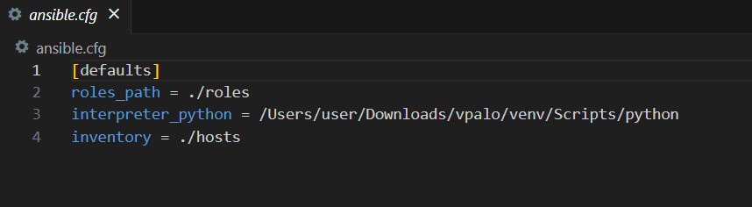
Ansible.cfg
Here the role_path is the path for the roles which consists of PaloAltoNetwork.paloaltonetworks
Interpreter_python is the path for the python
And inventory is for the path of hosts.ini file
To load the libray of Palo Alto network use the command: ansible-galaxy PaloAltoNetwork.paloaltonetworks

Slide 7
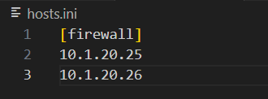
Hosts
Add the ips of the hosts users.

Slide 8
Ansible vault
This is used to store encrypted variables
Use command: ansible-vault create vars.yml
Add a password for the vault

Slide 9
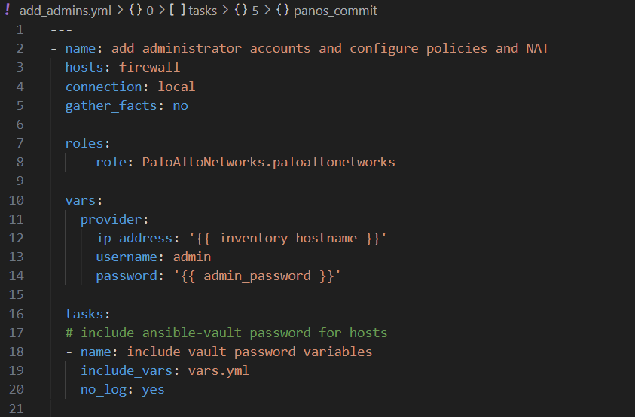
add_admins.yml
Here:
Name: Describes the overall purpose of the playbook.
Hosts: Targets the ini group firewall
Connection: Indicates that the tasks are executed locally rather than on the target machine.
Roles: Includes a pre-defined role for interacting with Palo Alto firewalls using the PAN-OS Ansible collection.

Slide 10
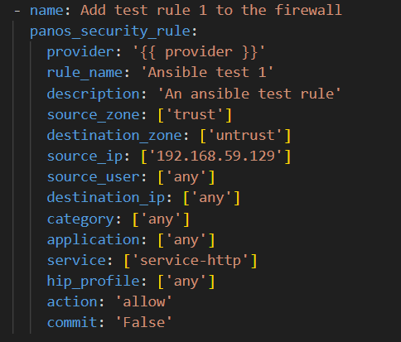
Security rule in (add_admins.yml)
Traffic flows from the trust zone to the untrust zone.
Allows traffic from the source IP 192.168.59.129 to any destination.
Matches HTTP traffic and allows it.
Commit: Set to false, meaning changes are not immediately committed to the firewall.

Slide 11
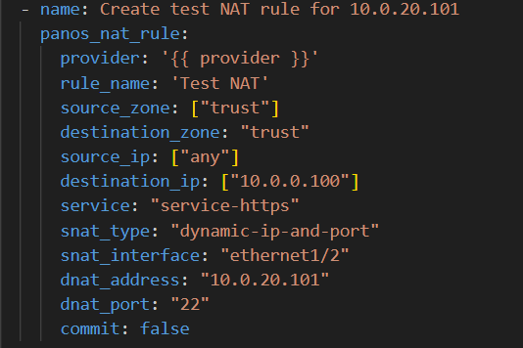
NAT rules
Rule Details:
Incoming traffic from the trust zone to 10.0.0.100 on HTTPS is:
Source-NATed (SNAT) to use a dynamic IP and port via interface ethernet1/2.
Destination-NATed (DNAT) to redirect traffic to 10.0.20.101:22 (SSH).
Commit: Not immediately committed.

Slide 12
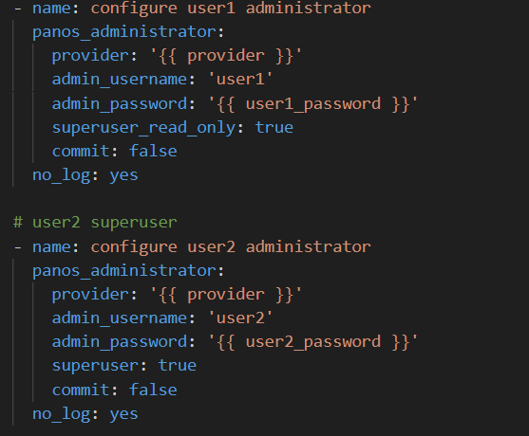
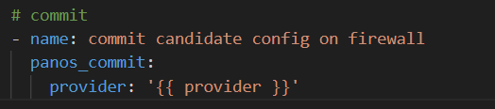
User 1 and 2 configuration
Creates a read-only administrator named user1 and user2.
The password is pulled from a variable (user1_password and user2_password).
Commits all pending configuration changes to the firewall, making them active.

Slide 13
Windows with WSL
Making connection through the managed nodes.
Prerequisites:
WSL
Ansible
Role: ansible-galaxy PaloAltoNetwork.paloaltonetworks

Slide 14
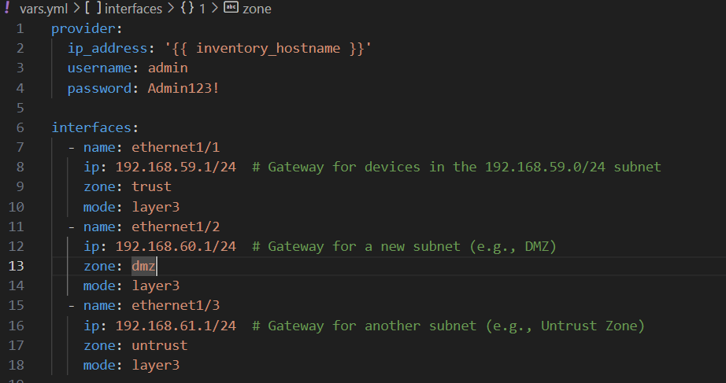
Vars.yml
ip_address: Uses the inventory firewall to dynamically assign the device's IP.
username: Username for administrative access.
password: Password for administrative access.
name: The interface identifier (e.g., ethernet1/1).
ip: The IP address and subnet mask for the interface (acts as the gateway for the subnet).
zone: The security zone associated with the interface (e.g., trust, dmz, untrust).
mode: Specifies that the interface operates in layer3 mode (routing traffic).

Slide 15
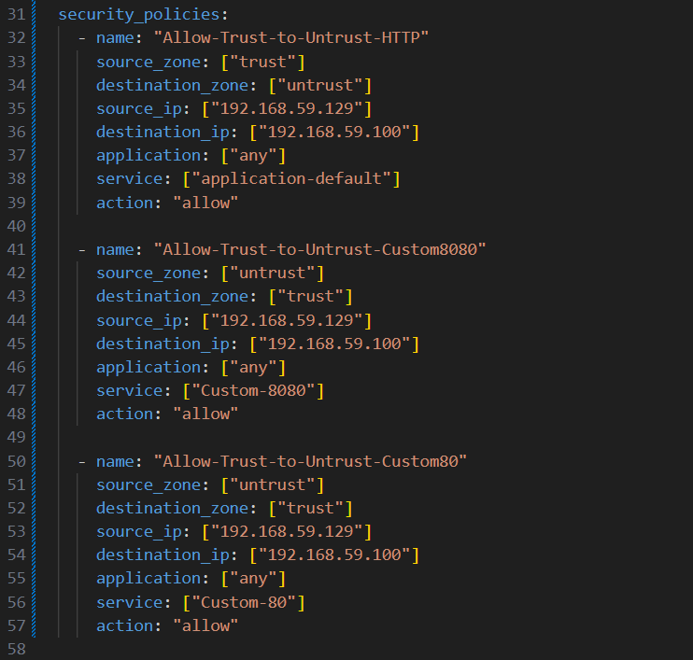
Security policies
name: A unique identifier for the policy.
source_zone and destination_zone: Security zones for traffic origination and destination.
source_ip and destination_ip: Specific source and destination IP addresses for the rule.
application: Specifies applications allowed (e.g., any for all).
service: Defines specific services or protocols (application-default or custom services).
action: Determines the action (e.g., allow or deny).

Slide 16
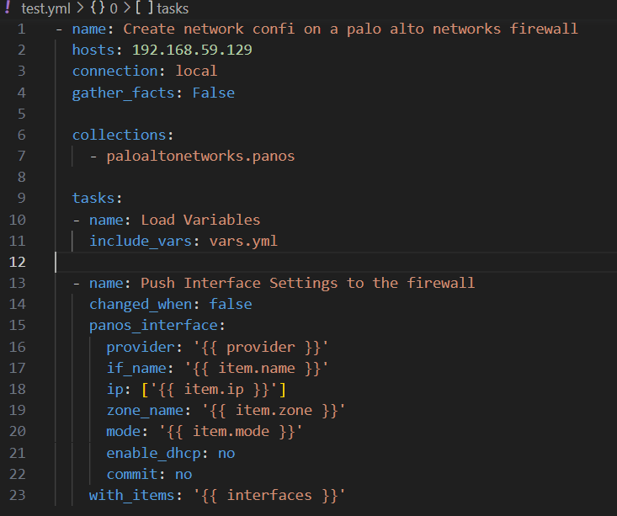
Test.yml
name: Describes the playbook's purpose, which is to configure network settings on a Palo Alto Networks firewall.
hosts: Specifies the target host (192.168.59.129), which is the firewall to configure.
connection: Uses local to execute tasks on the control machine (local system) rather than on the target.
provider: Credentials and connection information loaded from vars.yml.
if_name: Name of the interface to configure (e.g., ethernet1/1).
ip: The IP address and subnet mask assigned to the interface.
zone_name: Security zone associated with the interface.
mode: Operational mode of the interface (e.g., layer3 for routing traffic).
enable_dhcp: Whether DHCP is enabled (no here).
commit: Determines whether to commit changes (no here to prevent immediate commit).

Slide 17
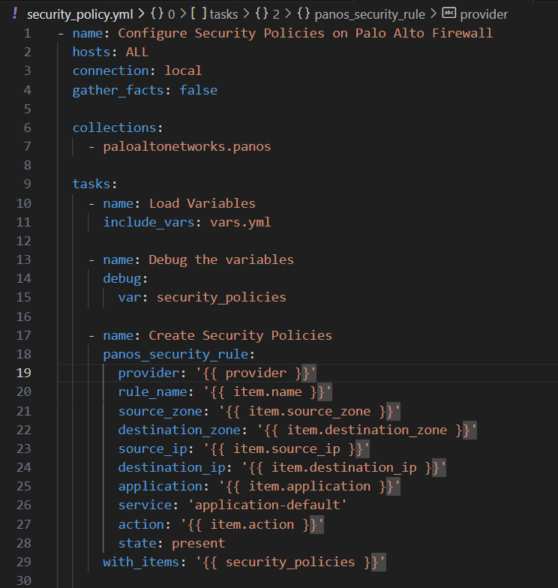
Security_policy.yml
provider: Firewall connection details from vars.yml.
rule_name: Name of the security rule.
source_zone & destination_zone: Security zones for the traffic.
source_ip & destination_ip: Source and destination IPs for the rule.
application: Specifies allowed applications (e.g., any or specific apps).
service: Sets the service to application-default, meaning the default ports for the specified application.
action: Specifies whether traffic is allowed or denyed.
state: Ensures the rule exists (present).
with_items: Iterates over the security_policies list in vars.yml.

Slide 18
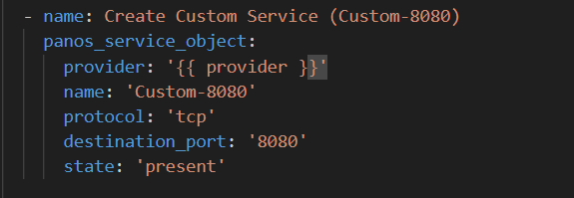
Custom Service (Custom-8080)
provider: Firewall connection details from vars.yml.
name: Name of the service object (Custom-8080).
protocol: Specifies the protocol (tcp).
destination_port: The destination port (8080).
state: Ensures the service object is created (present)

Slide 19
Configuration of Paloalto VM series
Log in using username: admin and password: admin
Change password
Commands:
>configure
>set deviceconfig system type static
>set deviceconfig system ip-address 192.168.59.129 netmask 255.255.255.0 default-gateway 192.168.59.1
>commit

Slide 20
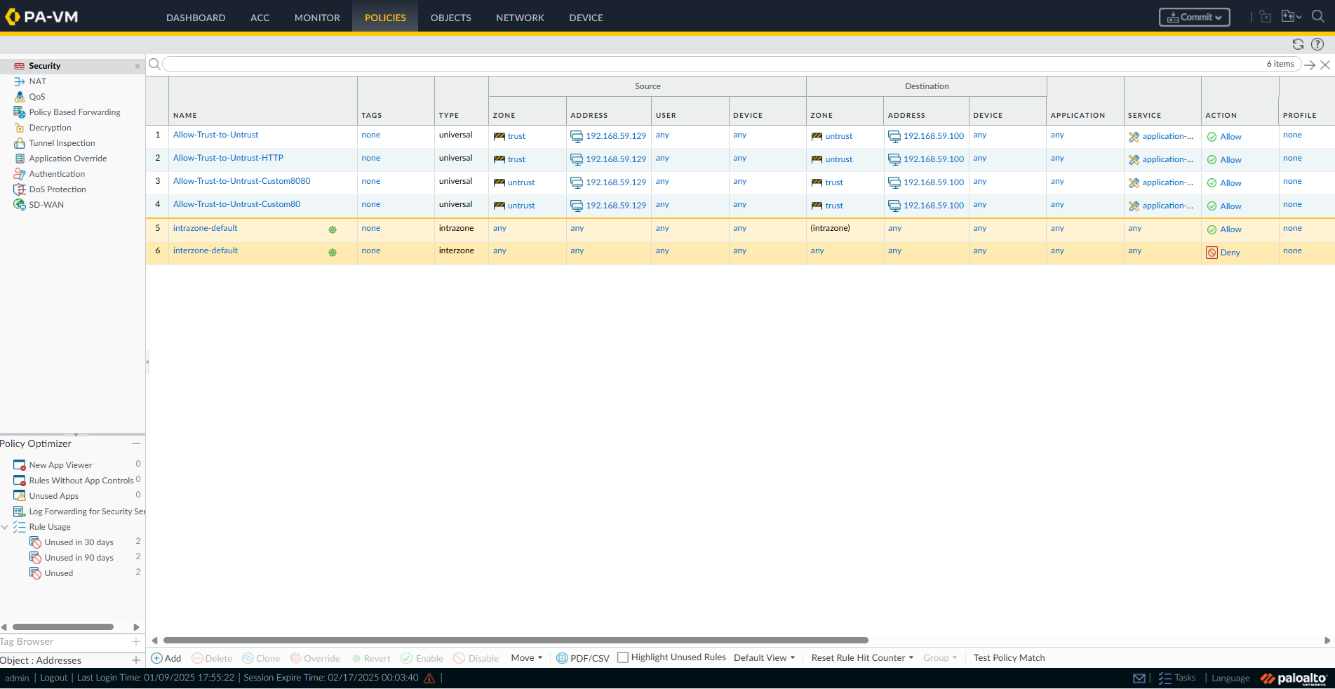
OUTPUTS
Adding policies

Slide 21
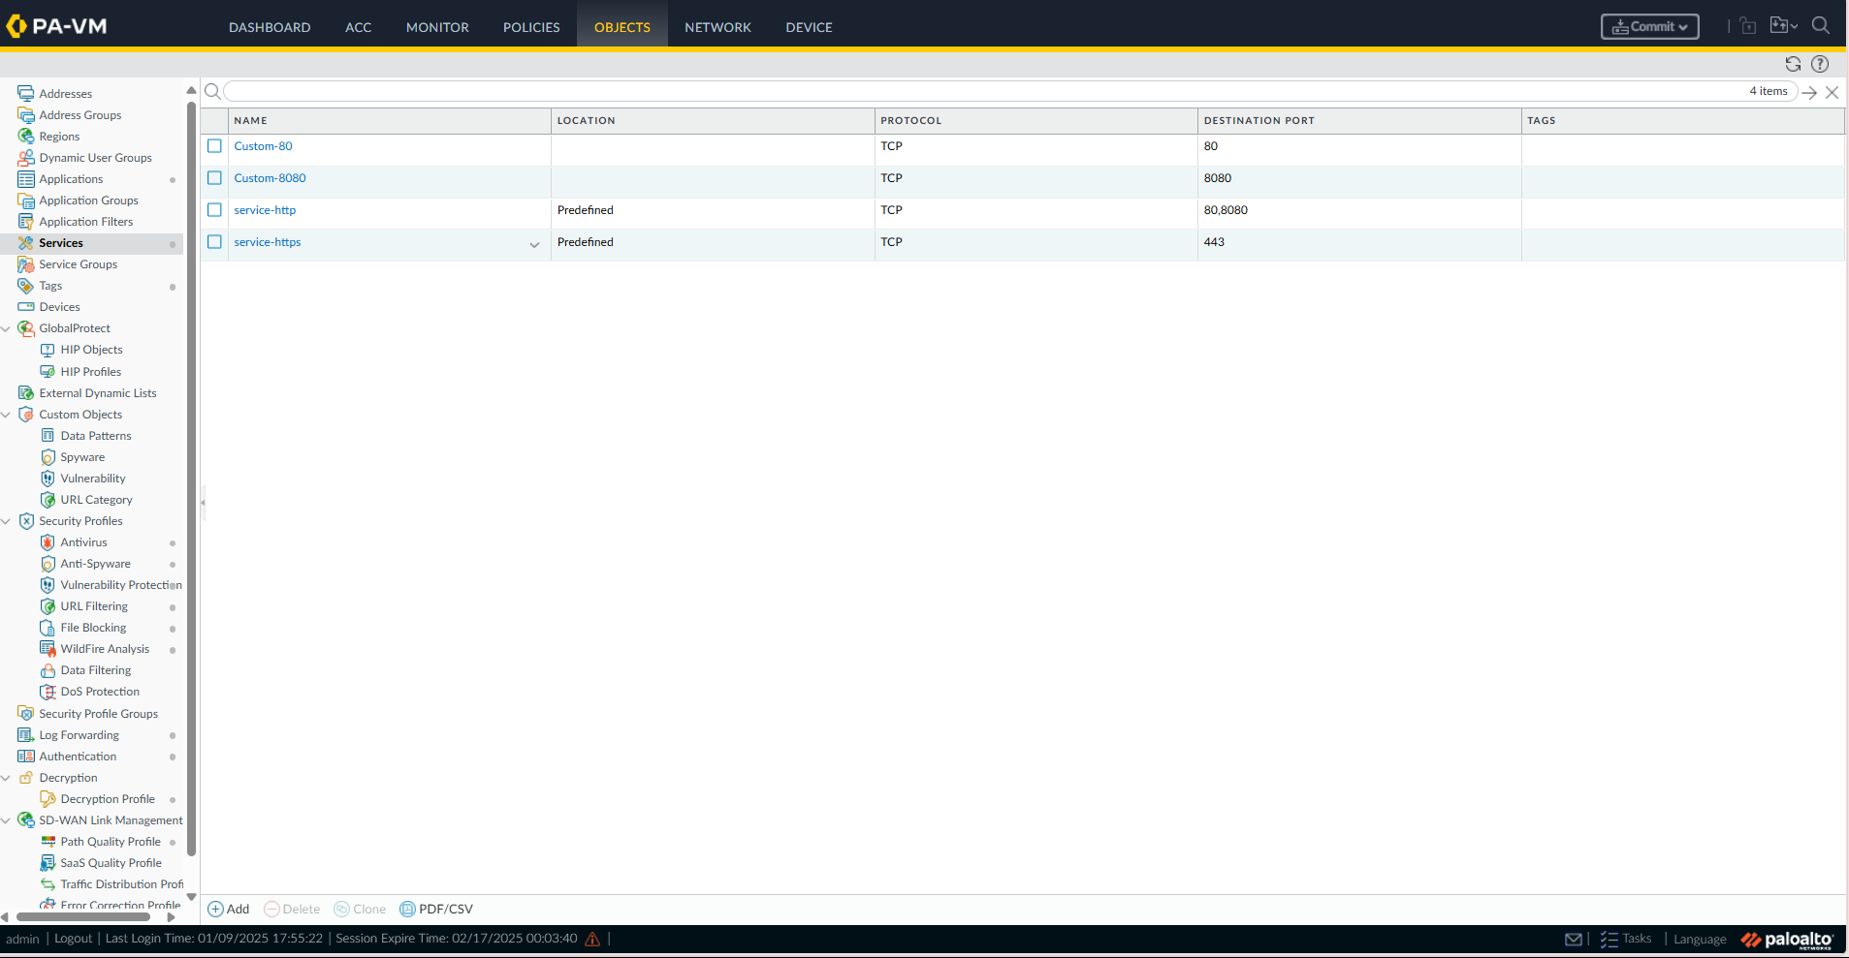
Services

Slide 22
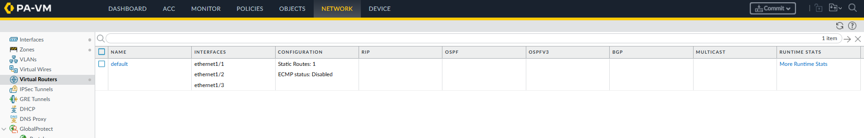
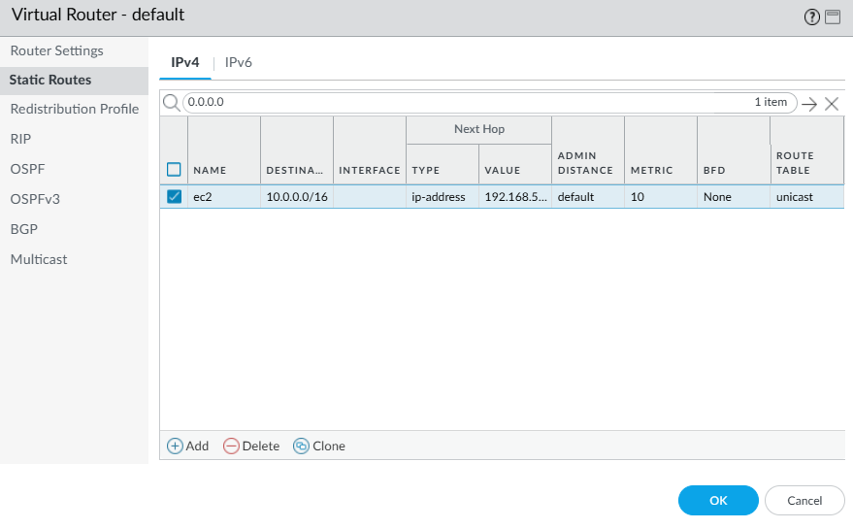
Virtual routers

Slide 23
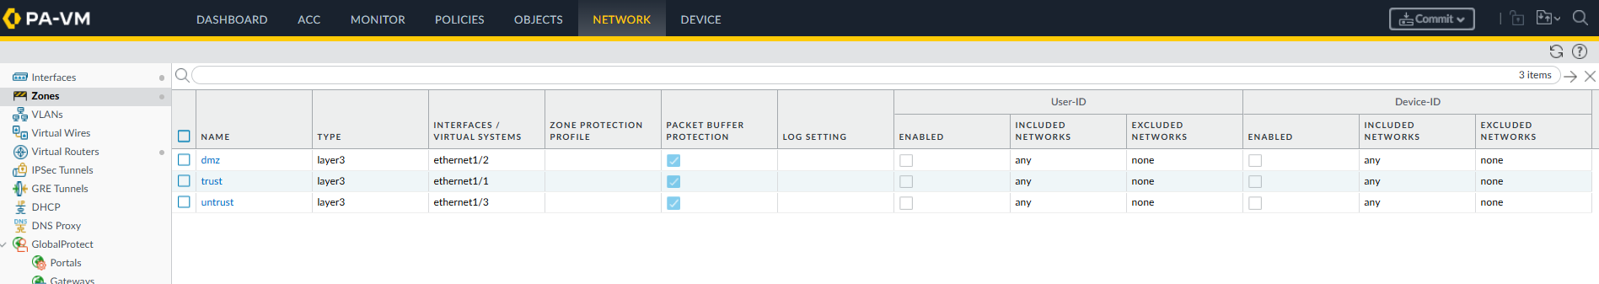
Zones

Slide 24
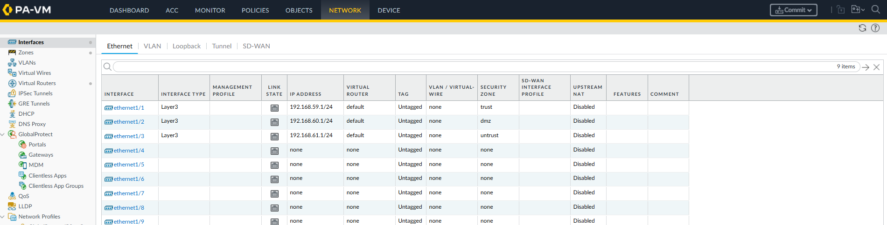
Interfaces

